Slide 1

앞면

Slide 2
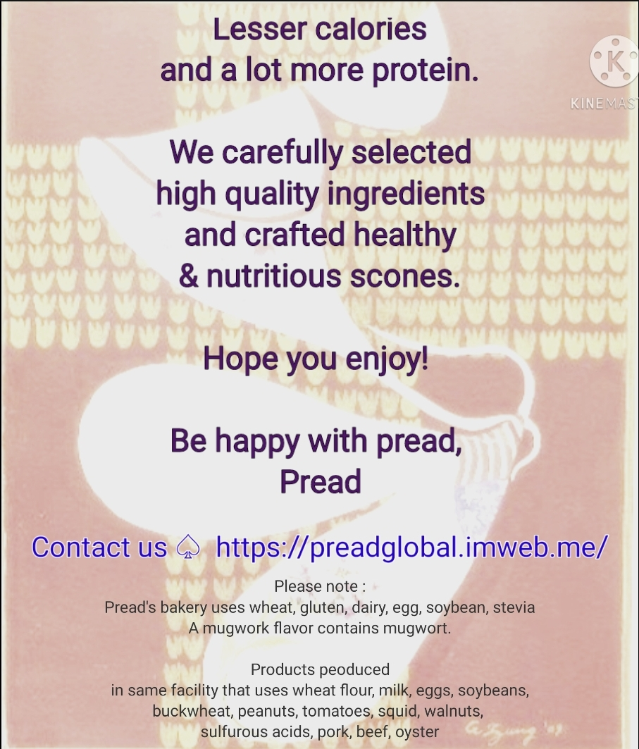
뒷면

Slide 3
뒷면 텍스트
Lesser calories
and a lot more protein.
We carefully selected
high quality ingredients
and crafted healthy
& nutritious scones.
​
Hope you enjoy!
​
Be happy with pread,
Pread
​
Contact ➔ https://preadglobal.imweb.me/
​
Please note :
Pread's bakery uses wheat, gluten, dairy, egg, soybean, stevia
A mugwork flavor contains mugwort.
​
Products peoduced
in same facility that uses wheat flour, milk, eggs, soybeans,
buckwheat, peanuts, tomatoes, squid, walnuts,
sulfurous acids, pork, beef, oyster

